Slide 1
The Movie Dataset Analysis Power BI
JAISURYA R
DADS
OCT 2024

Slide 2
Objectives
Evaluate Box Office Performance
Analyze Movie Popularity Trends
Compare Revenue vs Budget Efficiency
Analyze popular movies and genres
Identify Key Market Insights

Slide 3
Dataset Overview
The Movie Dataset provides insights into movie performance, audience preferences, and industry trends. It helps analyze box office success and production impact across different genres.
Titles
Revenue
Genre
Production Company

Slide 4
Data Cleaning
Using power query removed duplicates
Replaced Null values
Removed unnecessary columns
Changed data types
Apply and Load

Slide 5
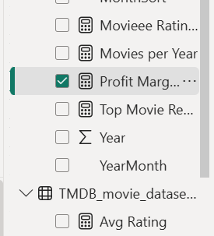
DAX functions
Profit Margin
Movie Count
Average Revenue
Movie Rating
Average Runtime

Slide 6
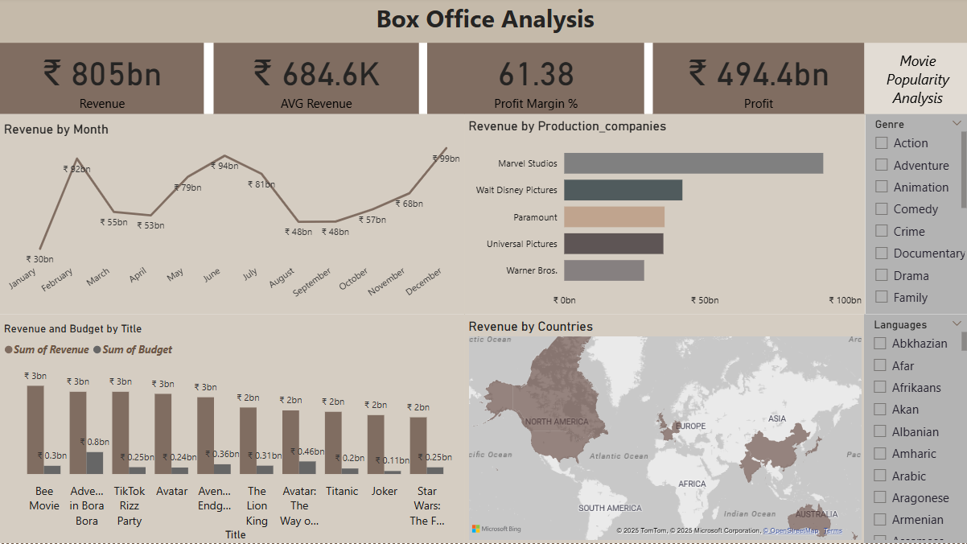
Dashboard 1

Slide 7
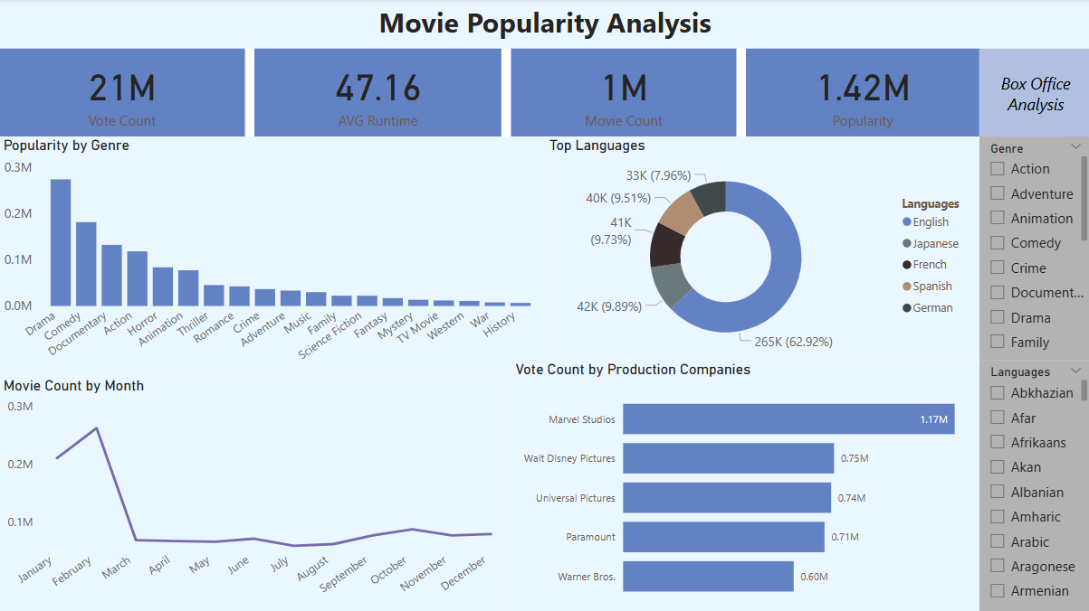
Dashboard 2

Slide 8
Insights
December has highest revenue
January has the lowest revenue
Marvel Studios generated highest revenue 92 billion
Bee Movie earned 3.2 billion on a 30 million budget
Most votes and popular Genre Drama , Comedy

Slide 9
Recommendations
History and War genre movies are the low popular genres.
Improving script and concept in these genres can lead more popular.
Low budget movies can give big revenue.
Production companies like Walt Disney and Warner Bros can take more movies for more revenue.

Slide 10
Conclusion
Understanding audience preferences supports genre selection, budgeting, and global market expansion.
This analysis helps production companies strategize release dates, budgets, and marketing efforts.
Assists screenwriters and directors in crafting films that align with successful patterns in revenue and popularity.

Slide 11
THANK YOU

